Slide 1


Throwaway Workers
Workplace psychosocial risks to mental health: National surveillance and the Australian Workplace Barometer project
And the revenge of the occupational health psychologists
Occupational Health Society of Australia (WA Branch)
Maureen Dollard
Asia Pacific Centre for Work Health and Safety, University of South Australia

Slide 2
My argument
Psychological health at work is a serious occupational health and safety issue
Organisational factors are a powerful influence on the health of the person at work
A driving pressure is to improve productivity, and profitability- and accumulate capital and therefore
Dispensible (throwaway) workers are ok
We need resilient organisations for resilient people-psychosocial safety climate key

Slide 3
Outline
Cost of work stress
Hierarchy of causes of worker health
Psychosocial safety climate theory
Results from Australia Workplace Barometer
Resilient systems-resilient workers

Slide 4
Costs of Work stress
Significant risk factor for both physical (cardiovascular disease (CVD)) (Blekic, et al., 2004) and
psychological health (e.g., depression) (LaMontagne, Keegel, Vallance, Ostry & Wolfe, 2008).
Stress-related illnesses are forecast to be the leading causes of the global disease burden by 2020 (Murray & Lopez, 1996).
Related lost productivity costs to Australian employers around $14.8 billion p.a., or 1.78% of GDP (Ecnotech, 2008).

Slide 5

$151million per annum direct costs stress claims

Slide 6
Organisation of Work
Influences on individual health and safety
External Context
Economic, legal, political, technological, and demographic forces at the national and international level
Economic developments (eg globalisation of economy)
Regulatory, trade, and economic policies (eg deregulation)
Technological innovations (eg information/ computer technology)
Changing worker demographics and labour supply (eg ageing population)
Organisational Context
Management structures, supervisory practices, production methods, and human resource policies
Organisational restructuring (eg downsizing)
New quality & process management initiatives (eg high performance work systems)
Alternative employment arrangements (eg contingent labour)
Work/family/life programs and flexible work arrangements (eg telecommuting)
Changes in benefits and compensation systems (eg gainsharing)
Climate and culture
Work Context
Job characteristics
Task attributes: temporal aspects, complexity, autonomy, physical and psychological demands
Social-relational aspects of work
Worker roles
Career development
Department of Health and Human Services (2002). The changing organisation of work and the safety and health of working people. (Publication No. 2002–116) Cincinnati, USA; The National Institute for Occupational Safety and Health (NIOSH).
Notes:
New Organisational Practices
to increase competition in global economy (NIOSH, 2002)
Organisational restructuring eg downsizing and outsourcing
Flexible and quality management (systems of work organisation)
eg Total Quality Management, lean production, modular manufacturing, high performance work systems
Use of temporary and contingent labour (flexiblisation of labour) Rapid expansion of the service sector
Increased utilisation of computer technology
Globalisation of the 24hr economy

Slide 7
Forecast emerging organisational, social and human work related risks
Changing labour markets
Changing work organisations
Impact on work characteristics
Unstable labour markets, precarious contracts
New forms of employment contracting practices
Job insecurity
Globalisation
Lean production, outsourcing
Intensification of work, high work load, work pressure
Van den Bossche, S., Smulders, P., Houtman, I. Trends and risk groups in working conditions, TNO 2006
Long working hours
Changing workforce
Impact on individuals
Poor work life balance
Ageing work force
Older workers

Slide 8
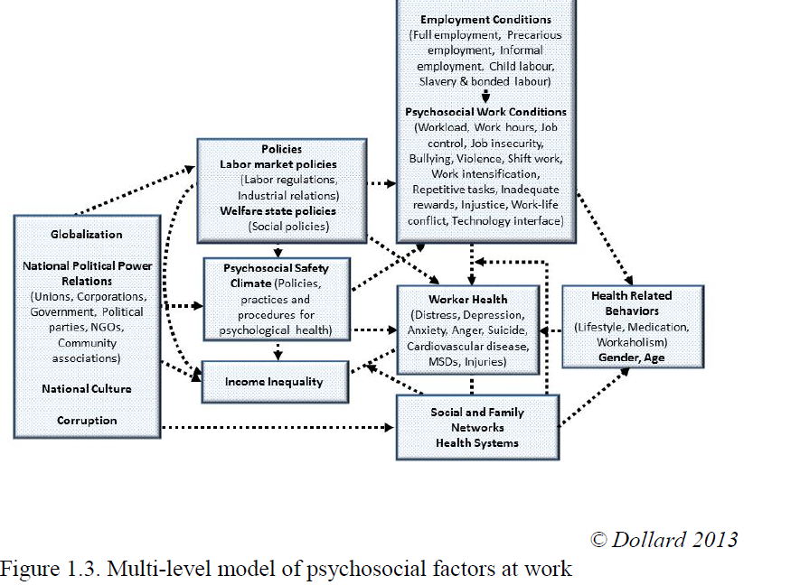
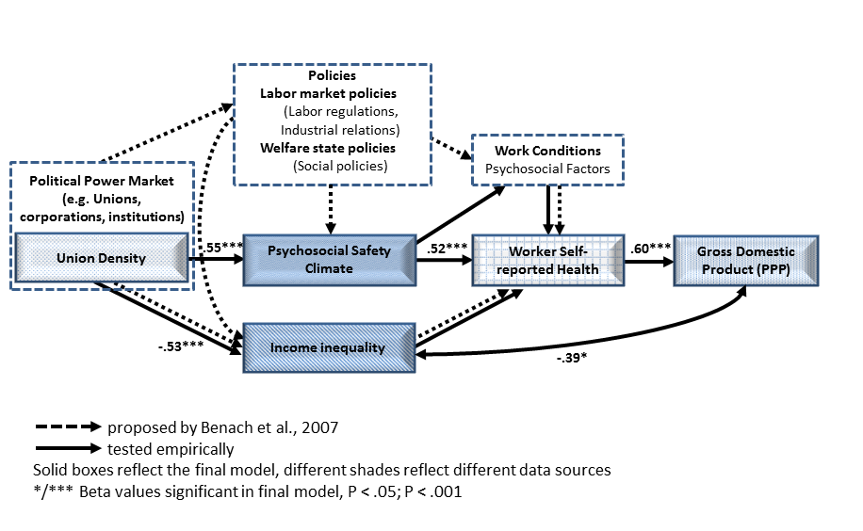

Slide 9
What worker characteristics are required for these ‘dispossessed’ environments?
According to a managing director of an Australian call centre there are two types of people who make successful cold callers: extroverts and psychopaths
extroverts because they thrive on interactions with others, and
psychopaths because they are not emotionally hurt by constant rejection (Warne-Smith, 2006).
Should we select for these characteristics?
How are we to work in such environments?
Warne-Smith, D. (2006). Confessions of a cold caller. The Weekend Australian Magazine, April 29-30, 16-20.

Slide 10
External
Organisational
Job design
Individual
Layers of influence on worker health

Slide 11
Policing
Community Demands
unemployment
public housing
nightclubs
income levels
D
R
Decision Making
Station
Station
Station
Station
D
D
R
R
Resources
Personnel
R
D

Slide 12
Current Context
Australian Productivity Commission 2010
Review of OHS
work-related stress and psychosocial hazards (e.g. work pressure, bullying and harassment)
not given the same attention in OHS legislation and by OHS inspectors as physical hazards

Slide 13
Job Design Level

Slide 14
Work stress theories
Job Demands-Control model, Karasek, 1979
Effort-Reward Imbalance model, Siegrist, 1996
Job Demands-Resources model, (Demerouti, et 2001)
Job demands are things that have to be done
Job resources help get the job done

Slide 15
Job Demands-Resources Model
Extended Health Erosion Path
?
Demands
Psychological
Health
Resources
Engagement
Extended Motivational Path

Slide 16
Towards a new theory
Psychosocial Safety Climate Theory

Slide 17
Organisational Level

Slide 18
Psychosocial safety climate
Theories matter “not just because theories influence the institutional arrangements, norms, and language of organizational management, but also because theories focus both research and public policy attention” (Pfeffer, 2010, pg. 40).

Slide 19
PSC Defined
Psychosocial safety climate (PSC) refers to shared perceptions regarding policies, practices, and procedures for the protection of worker psychological health and safety
Look to PPP for evidence of organisations true priorities (Zohar)

Slide 20
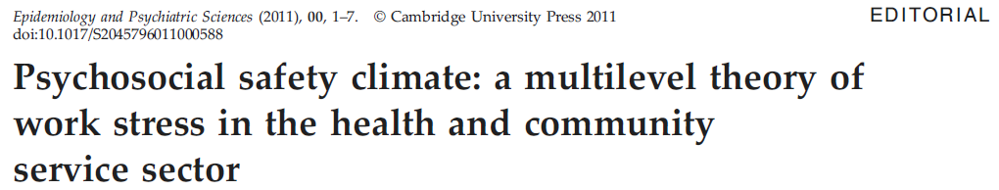
External Factors
Psychosocial safety
climate
Extended Health Erosion Path
Demands
Psychological
Health
Safety Outcomes
Accidents
Injuries
Errors
Quality of Service
Quality of Care
Psychosocial safety
climate
Resources
Engagement
Extended Motivational Path
Primary Prevention Secondary Intervention Tertiary Intervention

Slide 21
PSC Ingredients
Management commitment
1. In my workplace senior management acts quickly to correct problems/issues that affect employees’ psychological health
2. Senior management acts decisively when a concern of an employees’ psychological status is raised
3. Senior management show support for stress prevention through involvement and commitment
Priority
4. Psychological well-being of staff is a priority for this organization
5. Senior management clearly considers the psychological health of employees to be of great importance
6. Senior management considers employee psychological health to be as important as productivity
Communication
7. There is good communication here about psychological safety issues which effect me
8. Information about workplace psychological well-being is always brought to my attention by my manager/supervisor
9. My contributions to resolving occupational health and safety concerns in the organization are listened to
Participation and involvement
10. Participation and consultation in psychological health and safety occurs with employees’, unions and health and safety representatives in my workplace
11. Employees are encouraged to become involved in psychological safety and health matters
12. In my organization, the prevention of stress involves all levels of the organization

Slide 22
School study
School teachers, managers, supervisors, administration staff
18 schools
PSC aggregated to school level
significantly negatively related to sickness absence

Slide 23
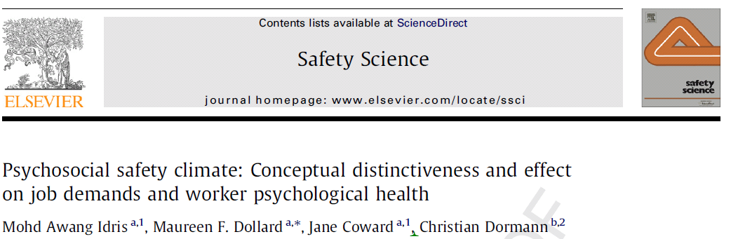

Slide 25
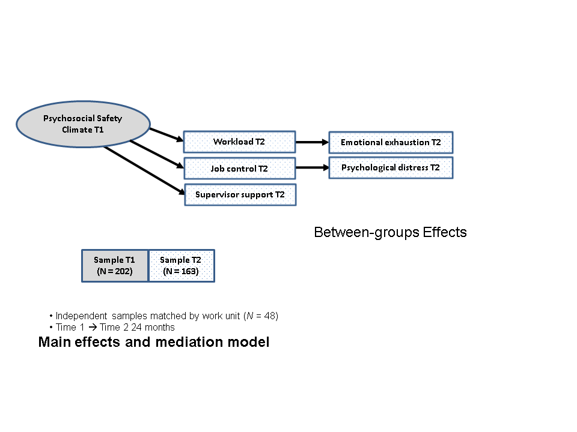
Psychosocial Safety Climate T1
Workload T2
Emotional exhaustion T2
Job control T2
Psychological distress T2
Supervisor support T2
Between-groups Effects
Sample T1
(N = 202)
Sample T2
(N = 163)
Independent samples matched by work unit (N = 48)
Time 1 → Time 2 24 months
Main effects and mediation model

Slide 26
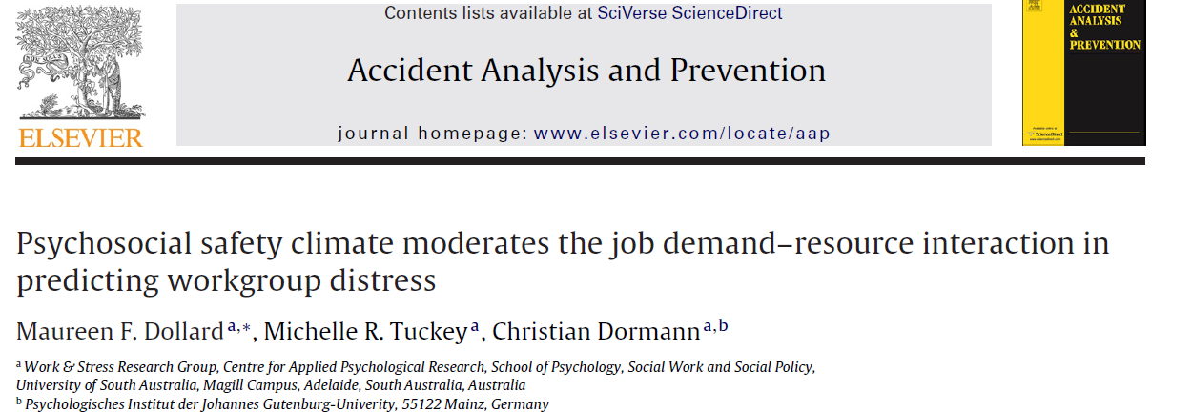
Police sample
Tests a three-way interaction
Demands X resources (in the context of PSC)

Slide 27
Study Design
Study Model 1
Cross-validation Model 2
Level 2
Level 2
N = 23 stations
PSC aggregated from all Time 1 (N = 319)
N = 23 stations
PSC aggregated from
Time 1 Dropouts
(N = 180)
Completely unrelated data
Level 1
Level 1
Time 1 and Time 2 matched
Longitudinal -Stayers
(N = 139)
Demands T1
Resources T1
Distress T1, T2
Time 1 and Time 2 matched
Longitudinal-Stayers
(N = 139)
Demands T1
Resources T1
Distress T1, T2

Slide 28
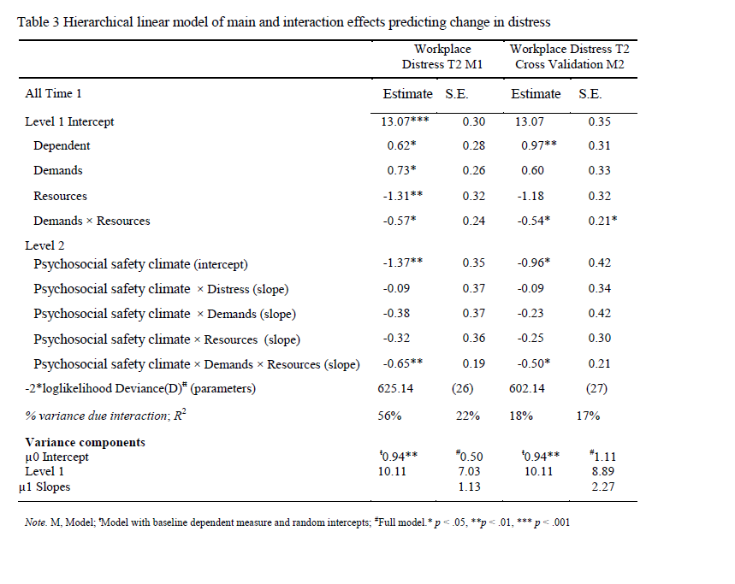

Slide 29
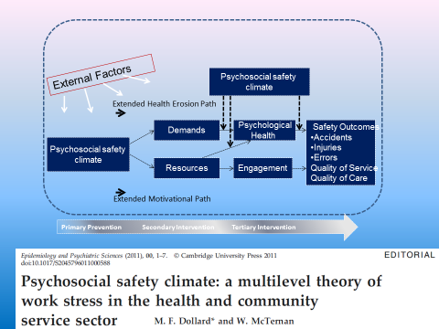

Slide 30
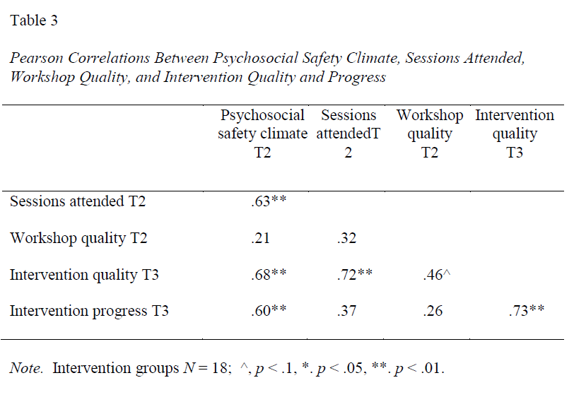
PSC affects Interventions
T

Slide 31
National Level

Slide 32

Australian Workplace Barometer project
Maureen Dollard
Anthony Winefield
Work and Stress Research Group
Centre for Applied Psychological Research, University of South Australia, Aust.
Tony LaMontagne
McCaughey Centre: VicHealth Centre for the Promotion of
Mental Health & Community Wellbeing, School of Population Health,
University of Melbourne, Australia
Anne Taylor
SA Health, Australia
Arnold Bakker
Erasmus University Rotterdam, The Netherlands
Cameron Mustard & Peter Smith
Institute for Work and Health, Toronto
ARC Discovery Grant DP0879007, ARC Linkage Grant, SafeWork SA, and SafeWork Australia

Slide 33
AUSTRALIAN WORKPACE BAROMETER
Launched February 2009
World-class national survey aimed to identify psychosocial factors that impact on people’s wellbeing and effectiveness at work-identify at risk groups
To conduct the first longitudinal general population-based test of the PSC model of work stress and job engagement
Data collected from all sectors (private, government, non-government organisations) and professions in the Australian workforce
Notes:
On Tuesday 26th February we launched the ARC supported Australian Workplace Barometer .
This is a world-class national survey aimed to identify psychosocial factors that impact on people’s wellbeing and effectiveness at work.
Data is being collected from all sectors (private, government, non-government organisations) and professions in the Australian workforce.

Slide 34


PuBlications
Presentations and publications
AWB book
Safe Work Australia report
Reports & enquiries

Slide 35
Australian Workplace Barometer
National surveillance project funded by Australian Research Council, Safe Work Australia and SafeWork SA
Now across all Australian states and territories
Population based study
Over 10000 Computer assisted telephone interviews
http://www.safeworkaustralia.gov.au/sites/swa/about/publications/pages/the-australian-workplace-barometer-report
Dollard, M.F. & Bailey, T. S. (Eds)., (2014). Australian Workplace Barometer: Psychosocial Safety Climate and working conditions in Australia, Samford Valley QLD; Australian Academic Press

Slide 36
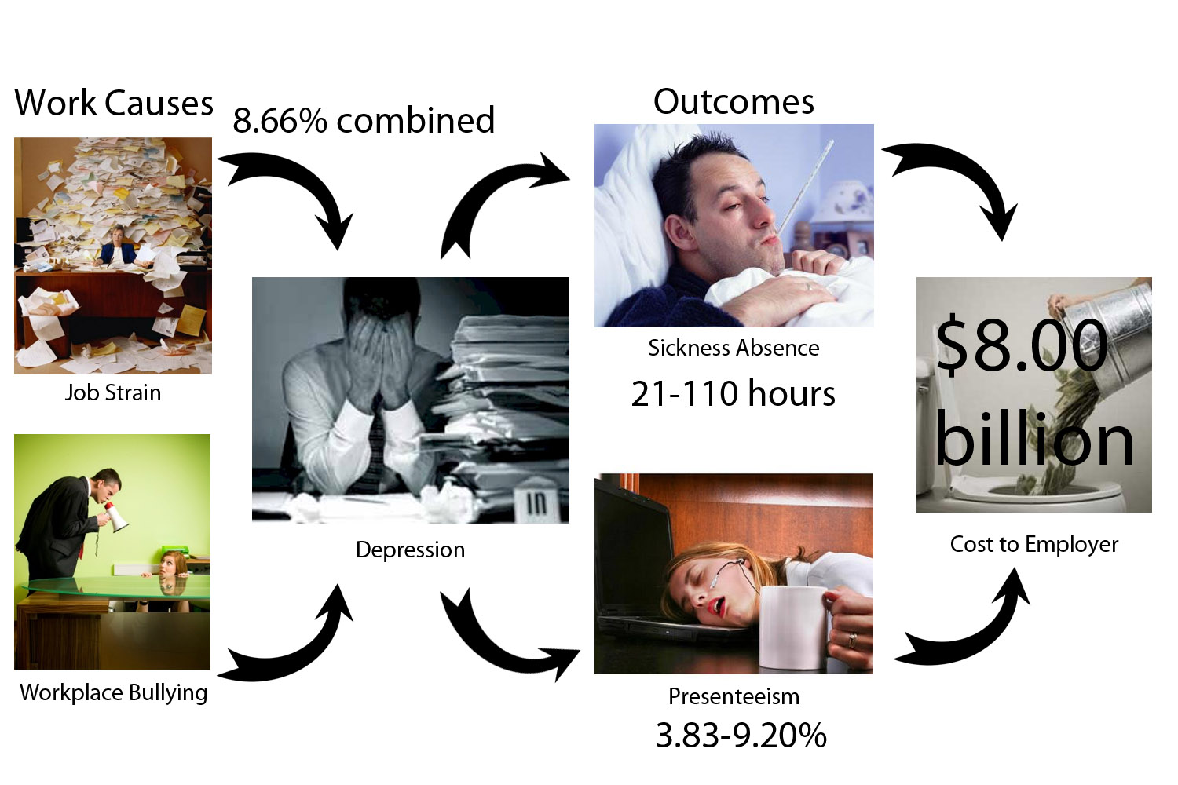
Depression costs
Wes McTernan
Notes:
So to bring it all together this little diagram summarises the main findings from the results. What our findings suggest is that increasing levels of depression lead to increasing levels of productivity loss, which we estimate costs Australian employers $8.00 billion annually.
Using a binary linear regression and PAR estimates we estimate that two key stressors, job strain and bullying contribute to 8.66% of that depression in the workplace.

Slide 37
Depression and costs to employer
Majority of the financial burden is caused by mild depression.
People with mild depression take 2 X as many sick days as people without depression.
People with severe depression take 5 X as many sick days.
Nearly 9% of the burden caused by two work factors-job strain, bullying

Slide 38
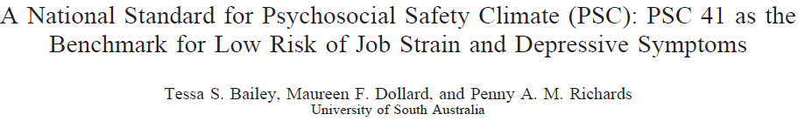
PSC-12 Standards; PSC range 12 – 60
PSC 41 or above…Low risk
PSC 37 or below.. High risk (35% of respondents)

Slide 41
PSC explained 9% of psychological health;
13% of variance in engagement.
A 10% increase in PSC within organisations → 4% decrease in demands,
5% decrease in bullying,
8% increase in resources,
3% reduction in psychological problems,
4% reduction in exhaustion, and
6 % increase in engagement.
The-Australian-Workplace-Barometer-report 2012
Dollard et al.

Slide 42
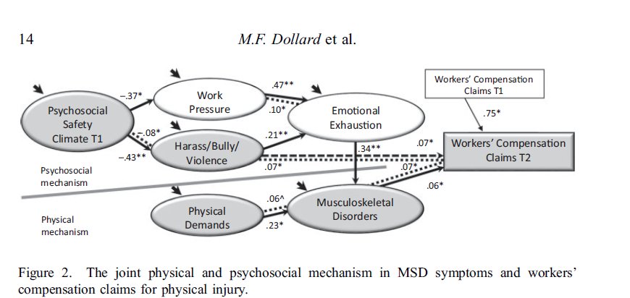
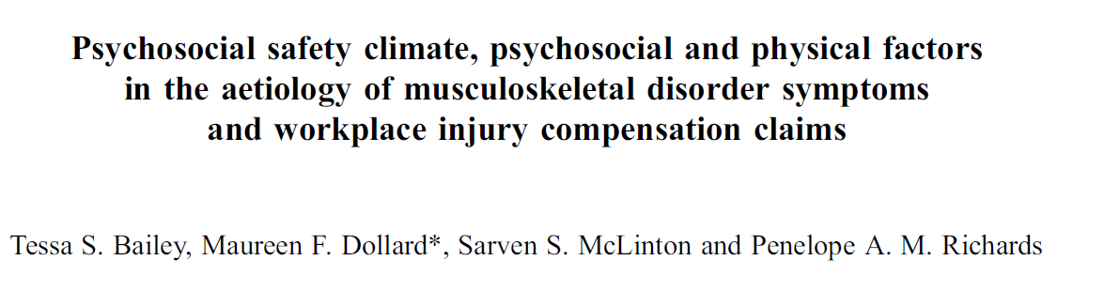
Work & Stress 2015

Slide 43
 | Bullying Time 1 2009/10 | Bullying Time 2 2011 | Bullying Time 3 2014/2015
Management Commitment Time 1 | -.254** | -.203** | -.134**
Management Priority Time 1 | -.190** | -.153** | -.136**
Organisational Communication Time 1 | -.161** | -.136** | -.100**
Organisational Participation Time 1 | -.139** | -.194** | -.088**
N = 1038 Australian workers

Slide 44
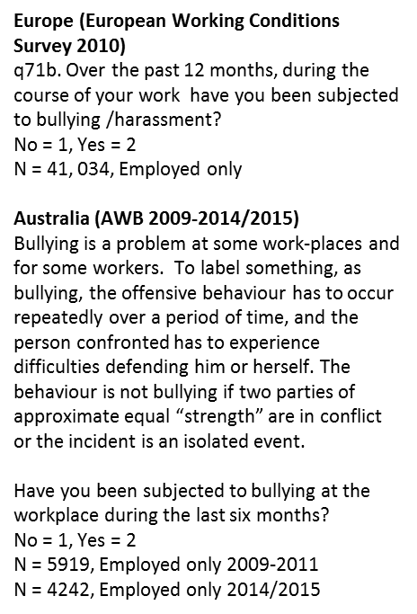

Slide 45
Australian States Bullying Rates 2009-2015

Slide 46
International Level

Slide 47
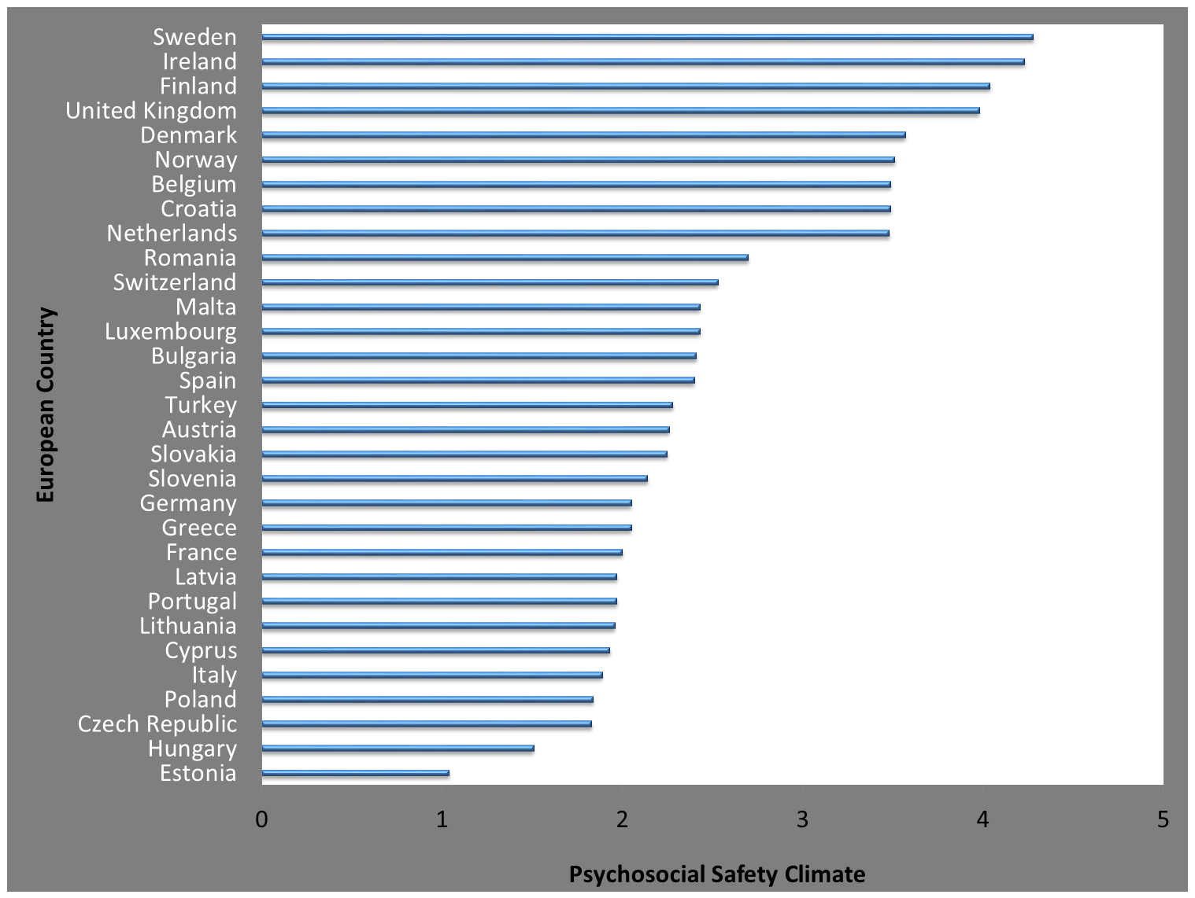

Slide 48
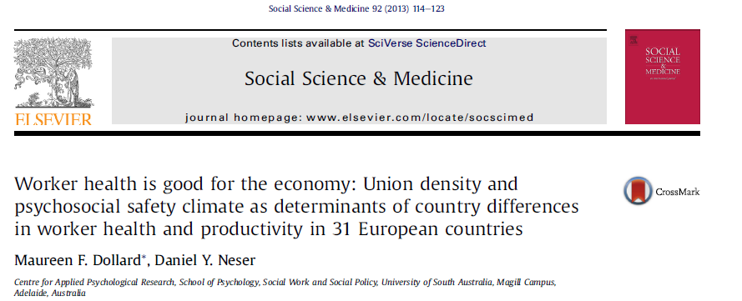

Slide 49
Interim summary points
Workplace protection (national / organisational) important for worker health
Bullying rates high in Australia
Specific bullying procedures common for bullying in SA but only a small relationship to less bullying: (But bullying could be worse without procedures) (-.12)
Psychosocial safety climate total (management commitment, priority, communication, participation) more strongly related to lower levels bullying (-.24)
Better implementation and enactment of appropriate well-targeted procedures-good practice policies need to be accompanied by practical guidance and process/context facilitators (PSC)

Slide 50
Practical Level

Slide 51


PSC predicts future procedures and change in bullying/harassment
Psychosocial Safety Climate T1
2.45*, 1.01
2.39**, .76
-.13**, .04
Bullying/
Harassment Procedures T2
Bullying/
Harassment Procedures T3
-.12*, .05
-1.36**, .22
Bullying/
Harassment T1
Bullying/
Harassment T2
Bullying/
Harassment T3
ns
.44**, .14
1.80**, .39
2010 2011 2014/2015
All effects are between-group effects;
Individuals T1= 220, T2= 152, T3 = 94;
Organisations T1, T2 = 30, T3 = 27.

Slide 53
PSC Hierarchy of Control (PSC HOC)
Management
Priority
Senior management values: Organisational policy and procedure
Leadership: Middle management implementation and supervisor support
Job design: Demands, controls, support, resources
Organisational development: Human resource management, injury prevention, injury management, OHS units
Worker
Management Commitment
Organisational Participation
Organisational Communication
Bailey & Dollard, 2014

Slide 54
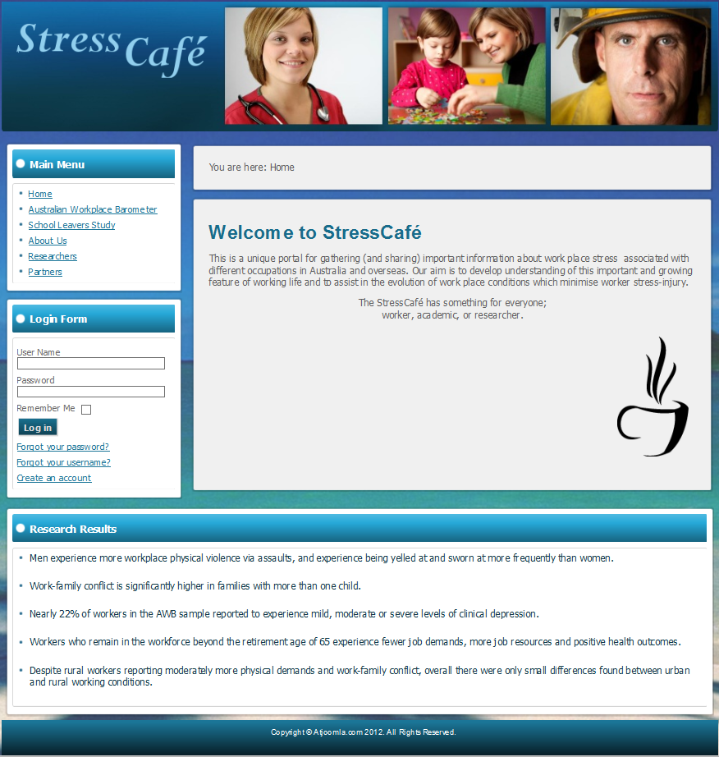

Slide 55
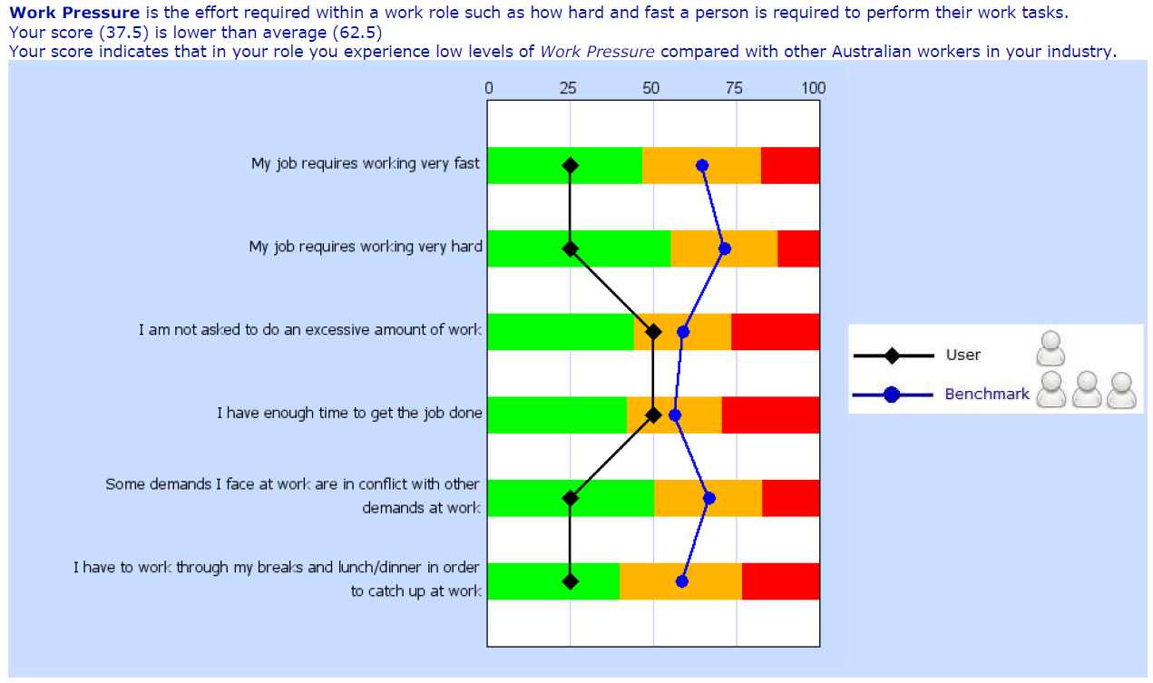

Slide 56
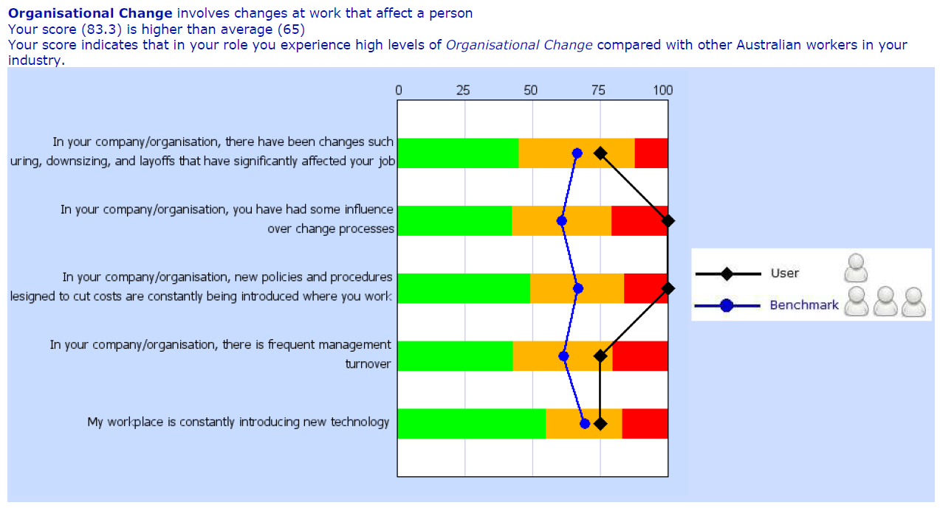

Slide 57
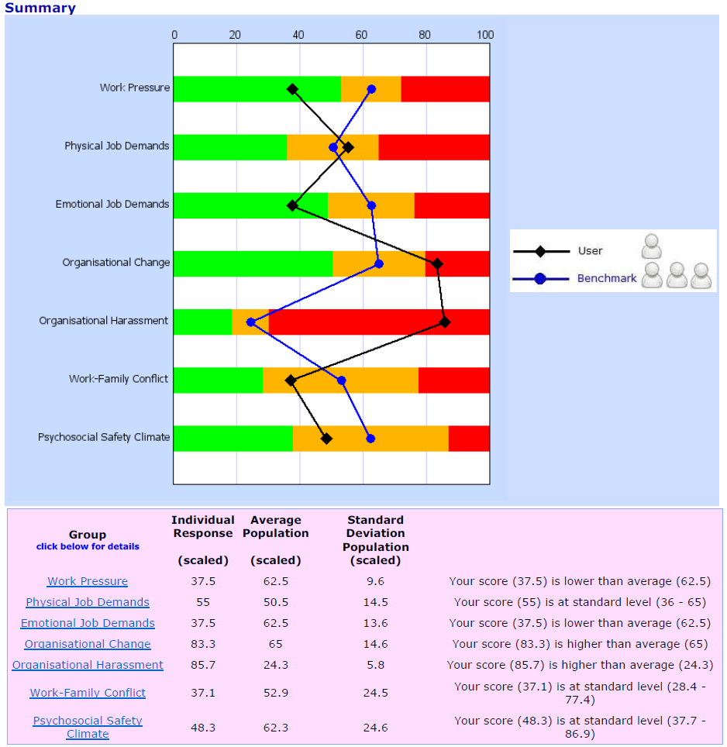

Slide 58
Organisational Resilience
Organisational resilience reflects the capacity of the organisation to cope with challenge, through flexible, adaptable and interactive systems, with psychosocial care.
Organisational resilience will be evident as better PSC, improved job design elements, improved employee health and resilience and improved work outcomes

Slide 59
Healthy Conducive Production Model
Environment
External resources, Expected, controllable
Controller
Management
Political will
Resources
Union relations
Surplus
Organisation
Neg-Entropy
Neg-Entropy
Social Level Controller
Collective/
Management
Conducive production
Strong PSC
Neg-Entropy
Neg-Entropy
Neg-Entropy Spiral Sub- coordination possible Strong PSC
External demands Random, Unexpected, Uncontrollable
Dollard & Karasek, 2008

Slide 60
Conclusion
Revision of the capitalist system
Resilience at work requires a resilient system that influences/sustains individual resilience
Psychosocial safety climate is an important component of a resilient organisational system
Interventions should aim to build resilient systems, and build psychosocial safety climate
Interventions at all levels –including national, state
National Surveillance -more frequently
Participation and ownership, Communication up and down
Matching resources to demands
All stakeholders involved especially union representation

Slide 61
Thank You
Contact
maureen.dollard@unisa.edu.au
Work & Stress Research Group
Centre for Applied Psychological Research
School of Psychology
University of South Australia

