Slide 1
Monitoring the Psychological Health of Employees and Conditions at the Workplace
Michael Tunnecliffe (Clinical Psychologist)

Slide 2
World Health Organisation (WHO):
“A state of wellbeing in which the individual … can cope with the normal stresses of life, can work productively and fruitfully, and is able to make a contribution to his or her community.”

Slide 3
Mental Health at Work
DISAFFECTION
DISTRESS
DISFUNCTION
DISORDER

Slide 4
Self, Family and Close Friends
Internet and the Media
Colleagues at Work
Supervisors
Where do people usually go for mental health advice and assistance?
Specialists at Work
Rehab Consultant, Medic, Nurse, Health or HR Advisor, Occ Phys
MHP
GP, Psychologist, EAP, Other Specialists

Slide 5
Work Health and Safety Act (WHS)
“Health” is defined in the WHS Act as both physical and psychological health
A range of factors can increase the likelihood of workers experiencing a ‘stress response’
  Exposure to a poorly designed or managed work environment
  Fatigue
  Traumatic events or workplace violence
  Bullying or harassment
  Excessive of prolonged work pressures.

Slide 6

Stress Responses
The physical, mental and emotional reactions which arise when workers perceive their work demands exceed their ability to cope.
Excessive or prolonged job stress can lead to:
  Absenteeism
  Staff turnover
  Task errors
  Safety issues
  Mental health issues
  Addictive behaviours.

Slide 7
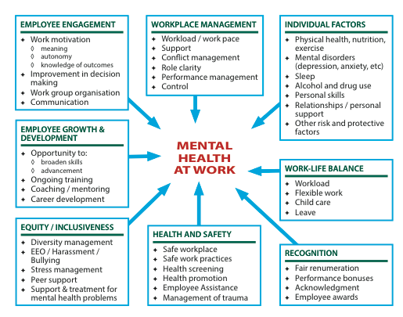

Slide 8
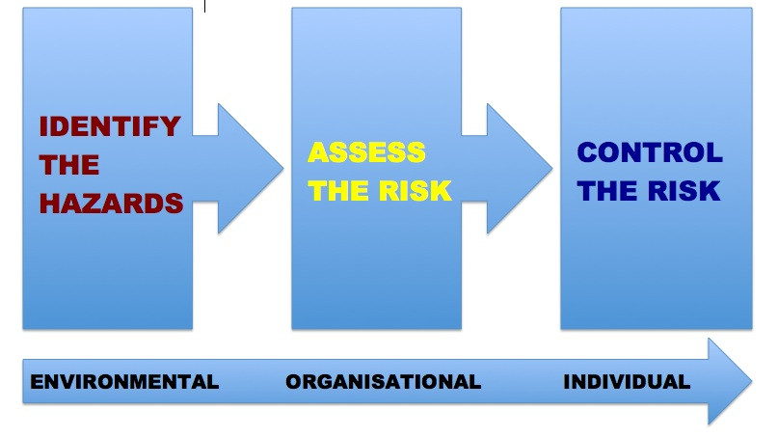

Slide 9
MENTAL HEALTH AUDITING vs
MENTAL HEALTH REVIEW
An AUDIT implies compliance or otherwise.
A REVIEW seeks to evaluate effectiveness.

Slide 10
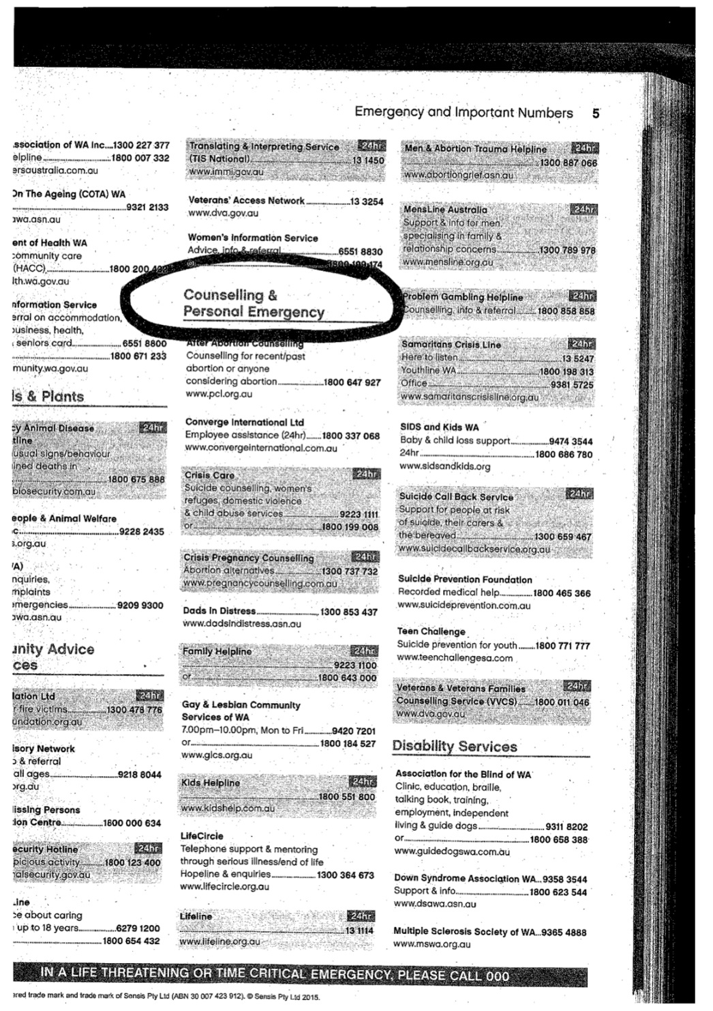

Slide 11
PRE-REVIEW CONSIDERATIONS
Determining the regulatory environment in which the review must take place in terms of relevant Acts, Regulations and Codes of Practice.
Developing an understanding of the organisation, its work processes and people.
Understanding the risks and protective factors
  nature of the work
  work conditions.
Identifying any “at risk” groups within the work
environment (e.g. minority groups).

Slide 12
Workplace Mental Health Review
Aims:
Identify the workplace and community risks to mental health.
Review the effectiveness of existing processes to manage these risks and promote mental health.
Make recommendations for improvements to the organisation’s management of mental health.

Slide 13
Workplace Mental Health Review
Focus:
12 key areas of Mental Health risk exposure in the workplace.
Method:
Key review questions
Policy reviews
Interviews with key people.
Evidence:
Documents
Training records
Data gathered
Handouts, posters, etc.

Slide 14
MENTAL HEALTH AUDIT
Survey of current MH policies and procedures
Identification of work factors or situations that may increase the level of stress or MH issues
  Nature of the work
  Work conditions
Identification and management of individuals, groups or roles at higher risk
Management of MH risk factors:
  Alcohol and Other Drugs
  Fatigue issues
  Bullying and Harassment
Leadership role of senior staff / specialists

Slide 15
MENTAL HEALTH AUDIT
6. Employee mental health promotion to increase:
  Protective factors
  Willingness to access support
Healthy Lifestyle promotion
Systems of support for individuals with MH issues to return to work and remain at work
Effective Critical Incident Response procedures
Assistance to address any personal or work related issues (Employee Assistance Program)
Colleague Support programs (Peer Support)
Auditing contractor compliance with MH policies.

Slide 16
DATA TO BE PROVIDED BY…
Reference groups
Managers and Front Line Supervisors
Training Manager
HR
H&S
Medical / Rehabilitation
Contacted providers (e.g. EAP personnel)
Contract Owners
Other Specialist personnel.

Slide 17
EVIDENCE REQUIRED COULD INCLUDE…
Policy documents and details of protocols used
Medical assessment forms and referral data
Pre-employment Screening
Training handouts, manuals, PPTs
Training attendance records
AOD testing records
Procedures / Outcomes to manage FFW breaches
MH brochures and resource sheets
Records of instructions, interviews, audits, etc…

Slide 18
EVIDENCE REQUIRED COULD INCLUDE…
Records of MH promotional events
Documented investigation procedures
Results of any organisational surveys
Details of programs in place
Emergency procedures and CIR reports
Emergency transport protocol
EAP agreement, promotional materials and EAP performance data
Records of contractor MH compliance audit.

Slide 19
CASE STUDY
2013: Workplace critical incident involving the death of an employee on site and serious injury to another.
Actions Taken:
Group information session before workers left the scene
Distribution of information sheets, EAP brochures / cards
Availability of on-site, off-site and phone counselling
Pro-active phone follow-up of all involved (2 calls)
Text message to anyone not contacted in person
Mid 2014: Employee on scene at the time of the incident takes legal action against employer for stress impact and lack of support, lodging a claim for lost wages and emotional pain and suffering. EAP critical incident report became an important record.

