Slide 1
Keeping regulations current
Dealing with evolving evidence on the causes of occupational disease
Lin Fritschi
Professor of Epidemiology
Curtin University

Slide 2
Outline
How does evidence change over time?
How is the evidence judged?
What happens when there isn’t enough evidence?
  Shiftwork
  Pesticides
What happens when there is enough evidence?
  Diesel exhaust

Slide 3
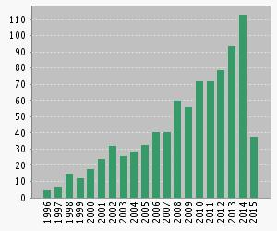
Number of articles on bisphenol A and cancer by year of publication

Slide 4
IARC
International Agency for Research in Cancer
Part of the World Health Organization
IARC Monographs Programme brings together international expert working groups who evaluate the evidence of the carcinogenicity of specific exposures
National health agencies can use this information as scientific support for their actions to prevent exposure to potential carcinogens.

Slide 5
IARC Working Group
Experts in 4 subgroups
  Exposure assessment
  Epidemiology
  Animal studies
  Mechanisms
Invited specialists
Representatives of national and international health agencies
Observers
Secretariat

Slide 6
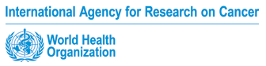
Subgroup work
Cancer in
humans
 Sufficient evidence
 Limited evidence
 Inadequate evidence
 Evidence suggesting lack of carcinogenicity
Cancer in
experimental animals
 Sufficient evidence
 Limited evidence
 Inadequate evidence
 Evidence suggesting lack of carcinogenicity
Mechanistic and
other relevant data
• Mechanistic data “weak,” “moderate,” or “strong”?
• Mechanism likely to be operative in humans?
Overall evaluation
 Group 1 Carcinogenic to humans
 Group 2A Probably carcinogenic to humans
 Group 2B Possibly carcinogenic to humans
 Group 3 Not classifiable as to its carcinogenicity to humans
 Group 4 Probably not carcinogenic to humans

Slide 7
Combining the human and experimental evaluations
EVIDENCE IN EXPERIMENTAL ANIMALS
Sufficient
Limited
Inadequate
ESLC
EVIDENCE IN HUMANS
Sufficient
Group 1 (carcinogenic to humans)
Limited
Group 2A
(probably carcinogenic)
Group 2B (possibly carcinogenic)
(exceptionally, Group 2A)
Inadequate
Group 2B
(possibly carcinogenic)
Group 3 (not classifiable)
ESLC
Group 4

Slide 8
Mechanistic data can be pivotal
EVIDENCE IN EXPERIMENTAL ANIMALS
Sufficient
Limited
Inadequate
ESLC
EVIDENCE IN HUMANS
Sufficient
Group 1
Limited
⬆1 strong evidence in exposed humans
Group 2A
⬆2A belongs to a mechanistic class where other members are classified in Groups 1 or 2A
Group 2B (exceptionally, Group 2A)
Inadequate
⬆1 strong evidence in exposed humans
⬆2A strong evidence … mechanism also operates in humans
Group 2B
⬇3 strong evidence … mechanism does not operate in humans
⬆2A belongs to a mechanistic class
⬆2B with supporting evidence from mechanistic and other relevant data
Group 3
⬆2A belongs to a mechanistic class
⬆2B with strong evidence from mechanistic and other relevant data
Group 3
Group 3
⬇4 consistently and strongly supported by a broad range of mechanistic and other relevant data
ESLC
Group 3
Group 4

Slide 9
Shiftwork and breast cancer
“Shiftwork that involves circadian disruption”
Probable human carcinogen (2A)

Slide 10
Combining the human and experimental evaluations
EVIDENCE IN EXPERIMENTAL ANIMALS
Sufficient
Limited
Inadequate
ESLC
EVIDENCE IN HUMANS
Sufficient
Group 1 (carcinogenic to humans)
Limited
Group 2A
(probably carcinogenic)
Group 2B (possibly carcinogenic)
(exceptionally, Group 2A)
Inadequate
Group 2B
(possibly carcinogenic)
Group 3 (not classifiable)
ESLC
Group 4

Slide 11
Human data (2010)
6 of 8 studies showed “modestly increased risk of breast cancer” for long term night shiftworkers
  Studies limited by
    Mainly studies of nurses
    Poor assessment of shiftwork
    Potential for confounding
7 of 8 cohorts of flight attendants showed increase risk of breast cancer with longer employment
  Studies limited by
    Poor assessment of circadian disruption
    Potential for confounding and detection bias

Slide 12
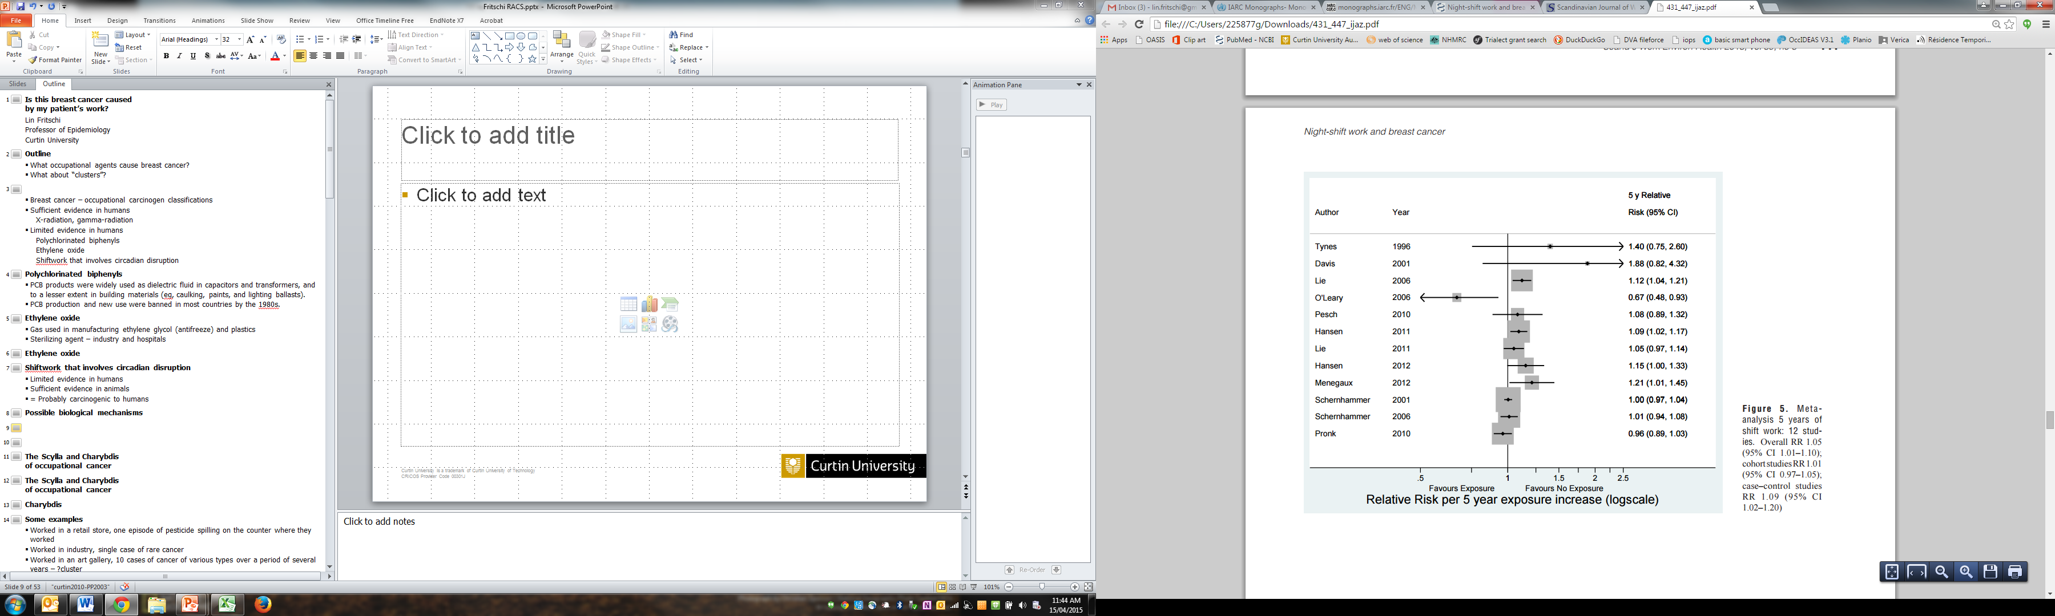
Ijaz
Overall 1.09 (1.02-1.20) in case-control studies, but 1.01 (0.97-1.05) in cohort studies
Ijaz et al, 2013

Slide 13
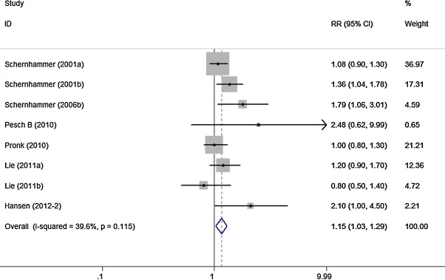
Forest plot of studies examining the association between ≥15 years of night work and breast cancer risk.
Yijun et al.2013

Slide 14
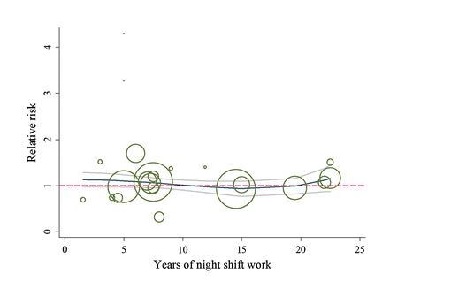
Dose response pattern
Kamdar et al, 2013

Slide 15
Some more confusion
Latest results from the Nurses Health Study:
  “Long-term rotating night shift work, particularly early in career, may be associated with an increased risk of breast cancer, which appears to diminish after nightshift work ceases.” Schernhammer, 2014
Erren’s hypothesis that night work is only carcinogenic if you are a lark rather than an owl. (Erren and Morfeld, 2014)
  However our Australian study didn’t support this. Fritschi et al, 2014
One study suggests survival is worse in those who have done shiftwork. (Hansen 2014)

Slide 16
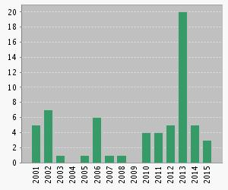
So, what to do?
No compensation so far in the Australian system for shiftwork and breast cancer
Small effect, no dose-response
Probably safe to wait until there is more evidence

Slide 17
Pesticides and cancer
As of 2014 Group 1 (definite) carcinogens were
  arsenic
  ethylene oxide
  2,3,7,8-tetrachlorodibenzo-p-dioxin (TCDD), which may occur as a contaminant in certain pesticides.

Slide 18



Images
http://www.beyondpesticides.org
http://www.preventcancernow.ca
http://www.ancestral-nutrition.com

Slide 19
Why is it so hard to determine carcinogenicity? (1)
Small numbers of subjects
  The highest exposure (agricultural) is relatively rare
  So researchers tend to combine individual pesticide exposures
  However there are 100s of pesticides with different chemical structures and it wouldn’t be expected that they would all act in the same way on the human body

Slide 20
Why is it so hard to determine carcinogenicity? (2)
Pesticide use is difficult to assess
  Multiple pesticide use
  No validated biomarkers
  Difficult to remember
  Changes over time
  Dose depends on a huge range of factors most of which are impossible to measure

Slide 21

An example – glyphosate and non-Hodgkin lymphoma (NHL)
Glyphosate is a broad-spectrum herbicide
Highest production volume of all herbicides
Increase in use because of genetically modified glyphosate-resistant crop varieties.

Slide 22
Human data = limited evidence
Study | Number of exposed cases | Number of exposed controls | OR | 95%CI
McDuffie et al, 2001, Canada | 51 | 133 | 1.2 | 0.83-1.74
De Roos et al, 2003, US | 36 | 61 | 2.1 | 1.1-4.0
Eriksson et al, 2008, Sweden | 29 | 18 | 2.0 | 1.1-3.7
Agricultural Health Cohort, 2005 US |  |  | 1.1 | 0.7-1.9

Slide 23
Combining the human and experimental evaluations
EVIDENCE IN EXPERIMENTAL ANIMALS
Sufficient
Limited
Inadequate
ESLC
EVIDENCE IN HUMANS
Sufficient
Group 1 (carcinogenic to humans)
Limited
Group 2A
(probably carcinogenic)
Group 2B (possibly carcinogenic)
(exceptionally, Group 2A)
Inadequate
Group 2B
(possibly carcinogenic)
Group 3 (not classifiable)
ESLC
Group 4

Slide 24
Animal studies = sufficient evidence
CD-1 mice, positive trend in the incidence of a rare tumour, renal tubule carcinoma.
Male mice, positive trend for haemangiosarcoma
Male rats (2 studies) increased rate of pancreatic islet-cell adenoma
A glyphosate formulation promoted skin tumours in an initiation-promotion study in mice.

Slide 25
Combining the human and experimental evaluations
EVIDENCE IN EXPERIMENTAL ANIMALS
Sufficient
Limited
Inadequate
ESLC
EVIDENCE IN HUMANS
Sufficient
Group 1 (carcinogenic to humans)
Limited
Group 2A
(probably carcinogenic)
Group 2B (possibly carcinogenic)
(exceptionally, Group 2A)
Inadequate
Group 2B
(possibly carcinogenic)
Group 3 (not classifiable)
ESLC
Group 4

Slide 26
Mechanistic evidence = strong
Has been detected in the blood and urine of exposed people, indicating absorption.
Can induce DNA and chromosomal damage.
Can induce oxidative stress
One study reported increases in blood markers of chromosomal damage (micronuclei) in residents of several communities after spraying of glyphosate formulations.
Bacterial mutagenesis tests were negative.

Slide 27
Mechanistic data can be pivotal
EVIDENCE IN EXPERIMENTAL ANIMALS
Sufficient
Limited
Inadequate
ESLC
EVIDENCE IN HUMANS
Sufficient
Group 1
Limited
⬆1 strong evidence in exposed humans
Group 2A
Group 2B (exceptionally, Group 2A)
Inadequate
Group 2B
Group 3
Group 3
Group 3
ESLC
Group 3
Group 4

Slide 28
So, what to do?
No compensation so far in the Australian system for glyphosate and NHL
Potentially a larger effect, no evidence regarding dose-response
Agricultural and services users are likely to have highest exposures
Why not take precautions?
  Minimize use
  Wear masks, wear gloves and wash hands before eating or drinking

Slide 29
Recent IARC decisions on pesticides
Pesticide | Classification | Cancer
Lindane | Group 1 | NHL
DDT | Group 2A | ?NHL, testis, liver
Glyphosate | Group 2A | ?NHL
Malathion | Group 2A | ?NHL, prostate
Diazinon | Group 2A | ?NHL, lung
2,4,D | Group 2B
Tetrachlorvinphos | Group 2B
Parathion | Group 2B

Slide 30
Diesel engine exhaust – human data
6 cohort studies and 7 of 10 case-control studies showed an association with lung cancer
Risk of lung cancer about 2 to 3 times in highest exposed workers
Most studies show dose-response relationships

Slide 31
Combining the human and experimental evaluations
EVIDENCE IN EXPERIMENTAL ANIMALS
Sufficient
Limited
Inadequate
ESLC
EVIDENCE IN HUMANS
Sufficient
Group 1 (carcinogenic to humans)
Limited
Group 2A
(probably carcinogenic)
Group 2B (possibly carcinogenic)
(exceptionally, Group 2A)
Inadequate
Group 2B
(possibly carcinogenic)
Group 3 (not classifiable)
ESLC
Group 4

Slide 32
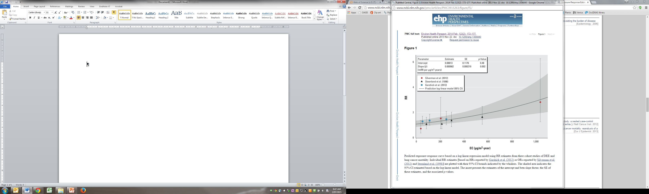
EHP

Slide 33
Excess lifetime risk of lung cancer per 1000 workers exposed from age 20 to age 65
Average EC (ug/m³) | Number of extra cancers to age 80
25 | 69
10 | 20
1 | 2
Vermeulen et al, 2014

Slide 34
AIOH recommendation
“Based on the available information, the AIOH believes that worker exposure to diesel particulate levels should be controlled to below 0.1 mg/m³ measured as submicron elemental carbon.
At this level irritation should decrease significantly and other adverse health effects may be controlled.”
AIOH POSITION PAPER: Diesel Particulate and Occupational Health Issues, 2007
100 ug/m³

Slide 35
Excess lifetime risk of lung cancer per 1000 workers exposed from age 20 to age 65
Average EC (ug/m³) | Number of extra cancers to age 80
25 | 69
10 | 20
1 | 2
Vermeulen et al, 2014

Slide 36
Considerations
What are the reputable bodies saying?
How strong is the possible effect?
Is there a dose-response effect?
Who is at highest risk?
What harm would come from using preventive measures?

Slide 37
Some reputable organizations
International Agency for Research on Cancer
US Environmental Protection Authority
American Conference of Governmental Industrial Hygienists (ACGIH)
European Chemicals Agency
National Industrial Chemicals Notification and Assessment Scheme

